Slide 1
Module 3
Unsupervised learning: Clustering-K-means, High, Hierarchical clustering,
Criterion functions for clustering, proximity measures, Euclidean, Manhattan, Minkowski Distances, Cosine Similarity.
Reinforcement Learning:
Agent based learning,
Q-learning,
Introduction to HMM (Hidden Markov Model)models

Slide 2
Why Unsupervised Learning
Unsupervised learning is harder
How do we know if results are meaningful? No answer labels are available.
Let the expert look at the results (external evaluation)
Define an objective function on clustering (internal evaluation)
We nevertheless need it because
Labeling large datasets is very costly (speech recognition)
Sometimes can label only a few examples by hand
May have no idea what/how many classes there are (data mining)
May want to use clustering to gain some insight into the structure of the data before designing a classifier
Clustering as data description

Slide 3
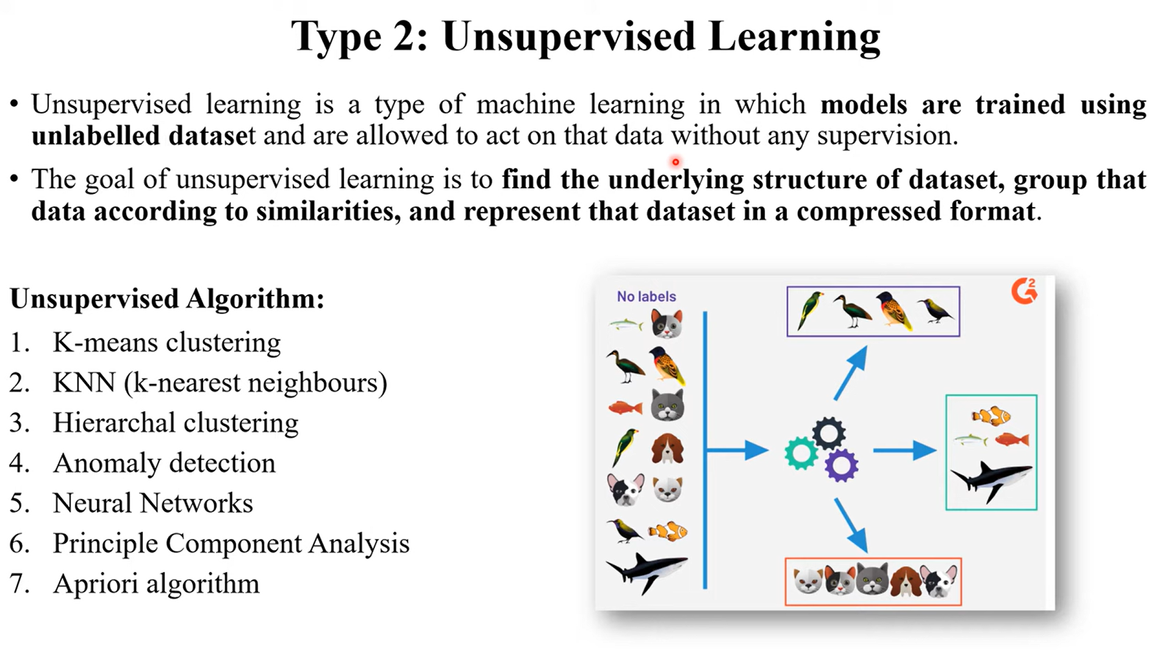

Slide 4
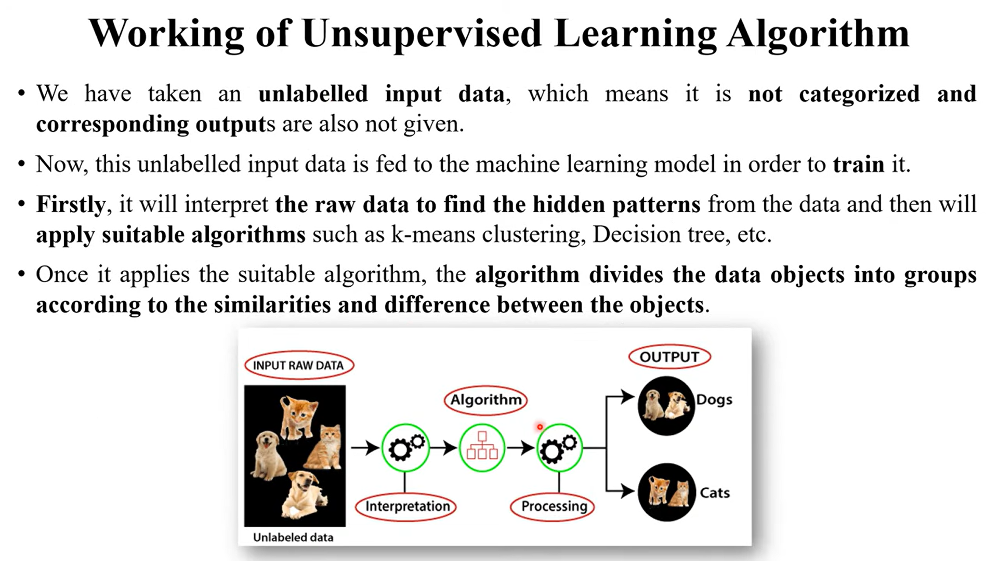

Slide 5
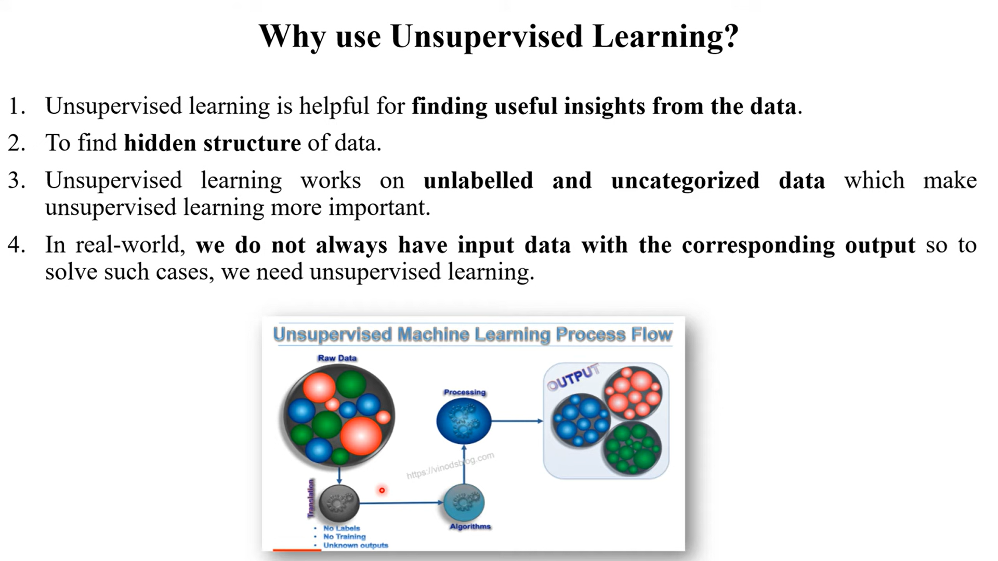

Slide 6
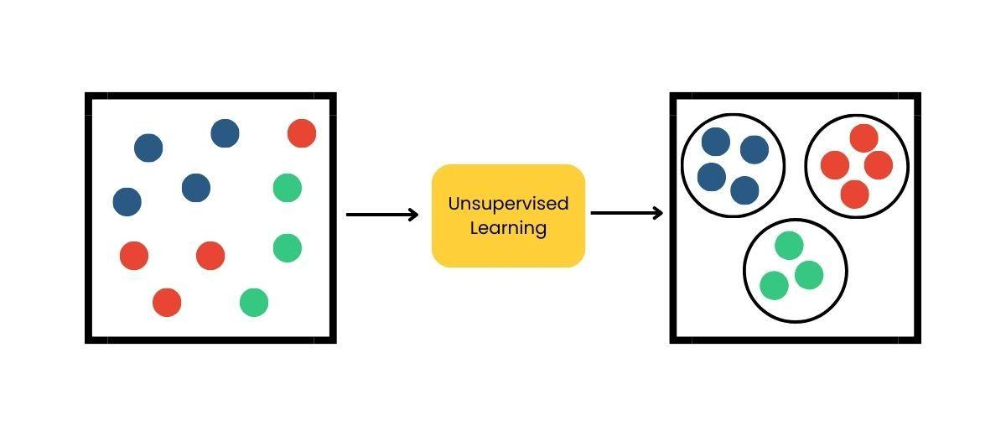
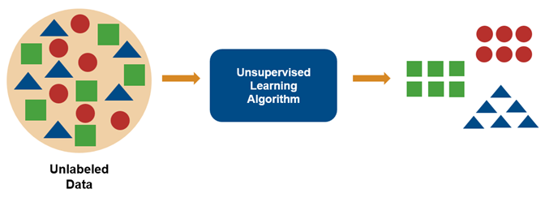
Unsupervised learning

Slide 7
Unsupervised learning
The system tries to learn without a teacher or label.
Some of the most important unsupervised learning algorithms
Clustering
K-Means, DBSCAN, Hierarchical Cluster Analysis (HCA)
Anomaly detection and novelty detection
One-class SVM, Isolation Forest,
Visualization and dimensionality reduction
Principal Component Analysis (PCA), Kernel PCA, Locally Linear Embedding (LLE), t-Distributed Stochastic Neighbor Embedding (t-SNE)
Association rule learning
Apriori, Eclat

Slide 8
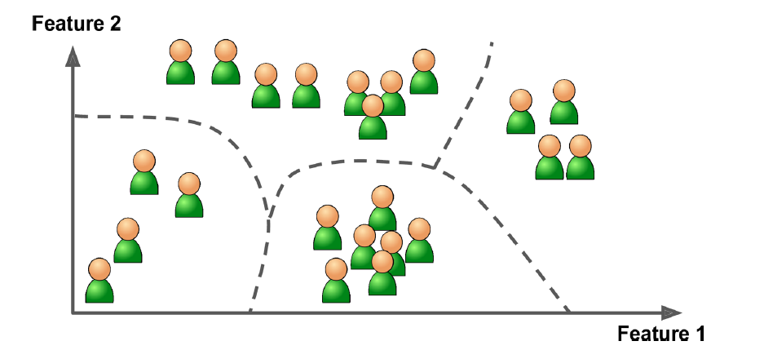
Unsupervised learning - Clustering
The goal is to group similar instances together into clusters. Clustering is a great tool for data analysis, customer segmentation, recommender systems, search engines, image segmentation, semi-supervised learning, dimensionality reduction, and more.

Slide 9
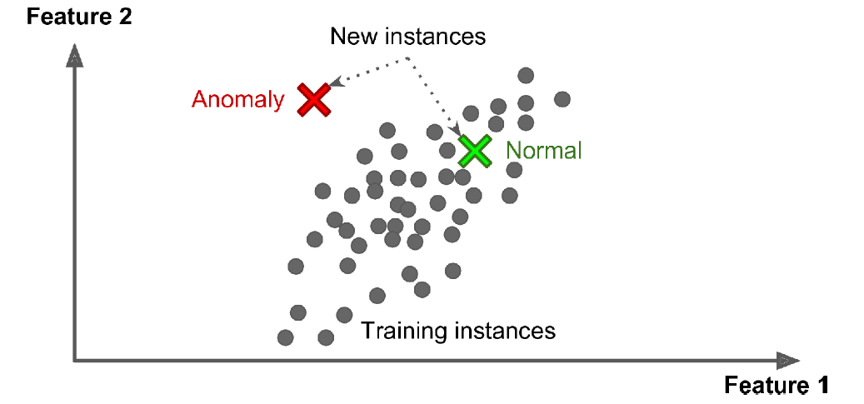
Unsupervised learning - Anomaly detection
The objective is to learn what “normal” data looks like, and then use that to detect abnormal instances, such as defective items on a production line or a new trend in a time series.

Slide 10
Unsupervised learning - Anomaly detection
Density estimation
This is the task of estimating the probability density function (PDF) of the random process that generated the dataset.
Density estimation is commonly used for anomaly detection: instances located in very low-density regions are likely to be anomalies.
It is also useful for data analysis and visualization.

Slide 11
The basic steps that an expert must follow in order to develop a clustering task are the following:
Feature selection: Features must be properly selected so as to encode as much information as possible concerning the task of interest.
Proximity measure: This measure quantifies how“similar”or“dissimilar”two feature vectors are. All selected features contribute equally to the computation of the proximity measure and there are no features that dominate others.
Clustering criterion. This criterion depends on the interpretation the expert gives to the term sensible, based on the type of clusters that are expected to underlie the data set.
Clustering algorithms: Having adopted a proximity measure and a clustering criterion, this step refers to the choice of a specific algorithmic scheme that unravels the clustering structure of the data set.

Slide 12
The basic steps that an expert must follow in order to develop a clustering task are the following:
Validation of the results: Once the results of the clustering algorithm have been obtained, we have to verify their correctness. This is usually carried out using appropriate tests.
Interpretation of the results: In many cases, the expert in the application field must integrate the results of clustering with other experimental evidence and analysis in order to draw the right conclusions.

Slide 13
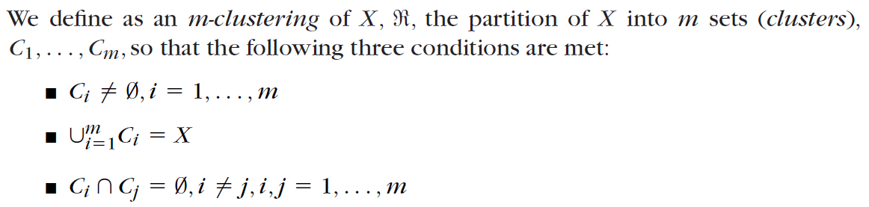
Clustering
Let X be our data set, that is, X {x1, x2, . . . , xN }
the vectors contained in a cluster Ci are “more similar” to each other and “less similar” to the feature vectors of the other clusters

Slide 14
Clustering
Hard or crisp clustering ➔ each vector belongs to a single cluster
What is a good clustering?
Internal (within the cluster) distances should be small
External (intra-cluster) should be large
Clustering is a way to discover new categories (classes)
What we Need for Clustering
Proximity measure, either
Dissimilarity(or distance) measure d(x,y): small if x,y are similar
Similarity measure s(x,y): large if x,y are similar

Slide 15
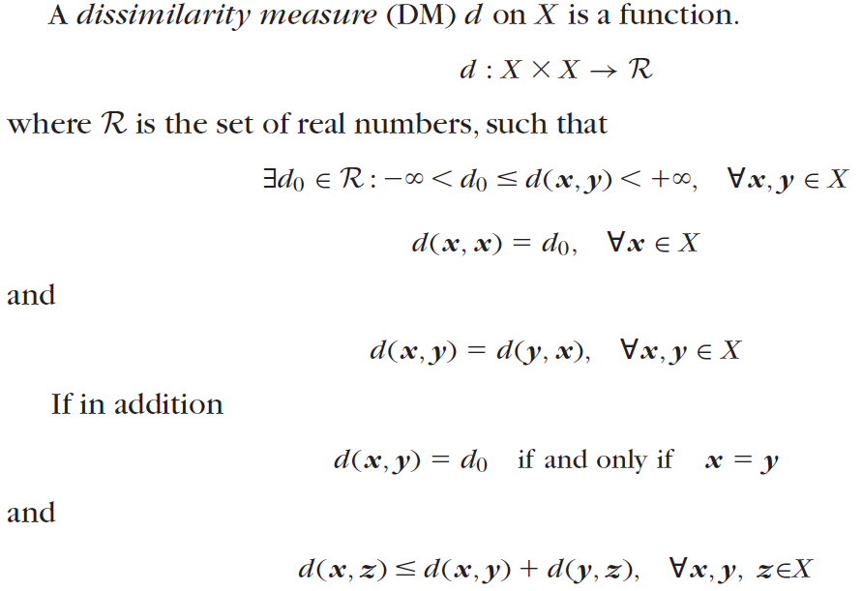
Triangular Inequality

Slide 16
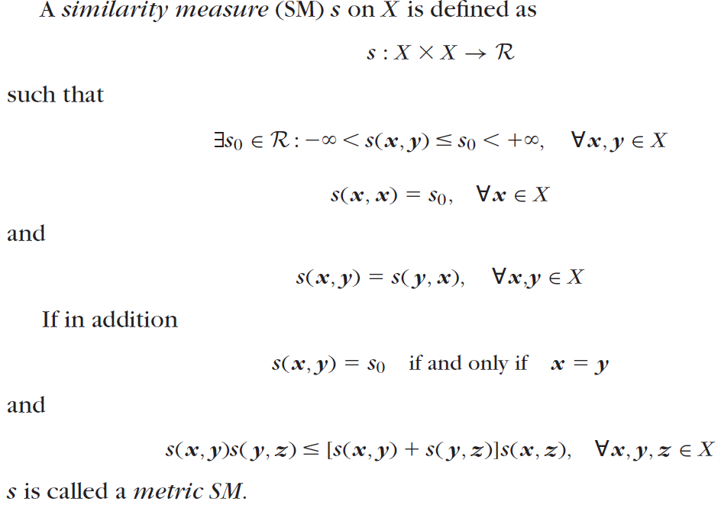

Slide 17
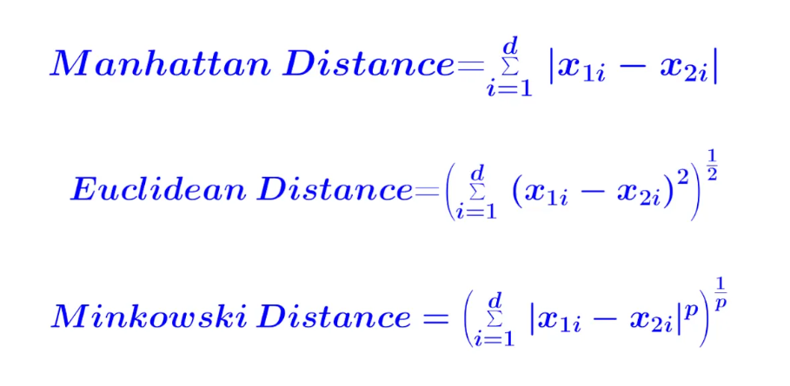
Dissimilarity(or distance) measure d(x,y)
Manhattan distance
Euclidean distance
Minkowski Distances

Slide 18
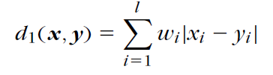
Manhattan distance
Special lp metric DMs that are also encountered in practice are the (weighted) l1 or Manhattan norm,

Slide 19
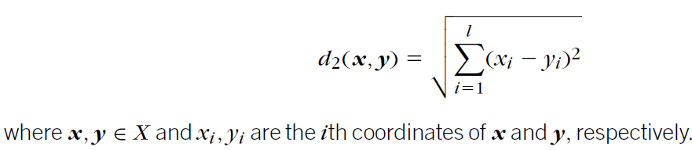
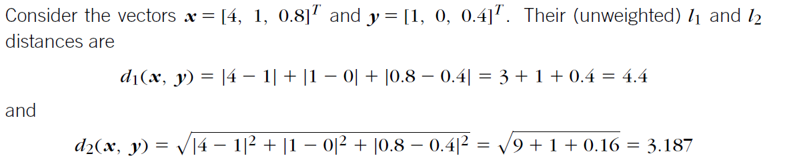
Euclidean distance
This is a dissimilarity measure on X, with d₀ = 0; that is, the minimum possible distance between two vectors of X is 0. Moreover, the distance of a vector from itself is equal to 0. Also, it is easy to observe that d(x, y) d( y, x).

Slide 20
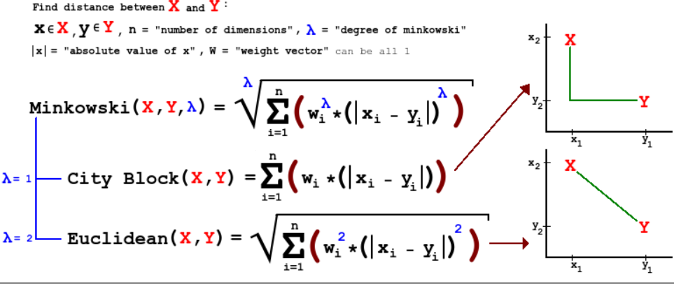
Minkowski Distances

Slide 21
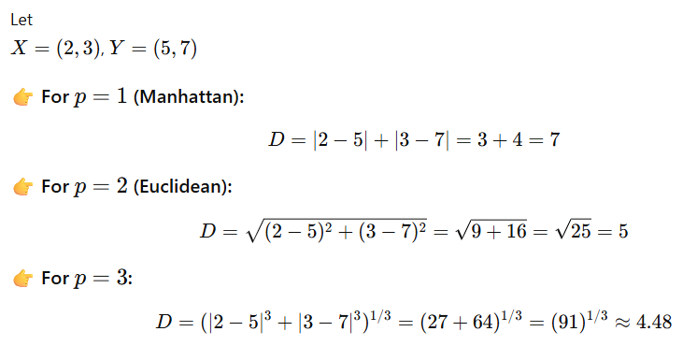
Dissimilarity(or distance) measure d(x,y)

Slide 22
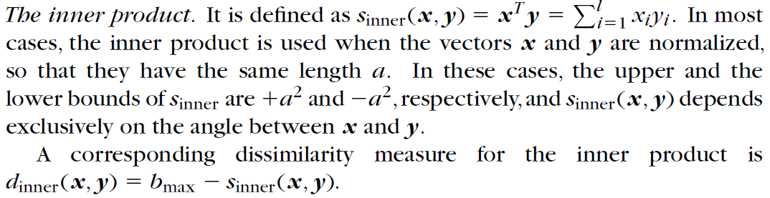
Similarity measure s(x,y)

Slide 23
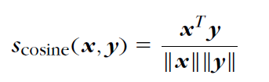
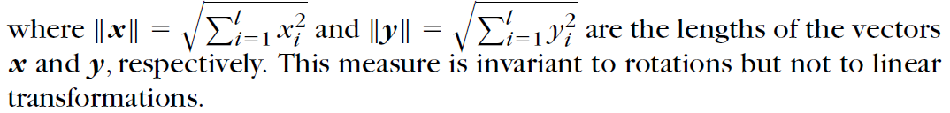
Cosine Similarity
Closely related to the inner product is the cosine similarity measure, which is defined as

Slide 24
Criterion functions for clustering
A criterion function for clustering is a mathematical measure used to evaluate and optimize the quality of clusters formed from a dataset.
Goal:
Minimize similarity within clusters (compactness)
Maximize dissimilarity between clusters (separation)
Types of Criterion Functions
Within-Cluster Sum of Squares (WCSS / SSE)
Between-Cluster Separation
Silhouette Coefficient
Dunn Index
Scatter

Slide 25


1. Within-Cluster Sum of Squares (WCSS / SSE)
Used in K-Means.
Where:
$C_{k}$= cluster k
$μ_{k}$= centroid of cluster k
$x_{i}$= data point
Minimizes variance inside clusters.

Slide 26


2. Between-Cluster Separation
Where:
$n_{k}$= number of points in cluster k
$μ_{k}$= cluster mean
$μ$= global mean
Maximizes distance between clusters.

Slide 27


3. Silhouette Coefficient
Where:
$a\left(i\right)$= average distance within same cluster
$b\left(i\right)$= average distance to nearest cluster
Range: −1 to +1
Higher value = better clustering.

Slide 28


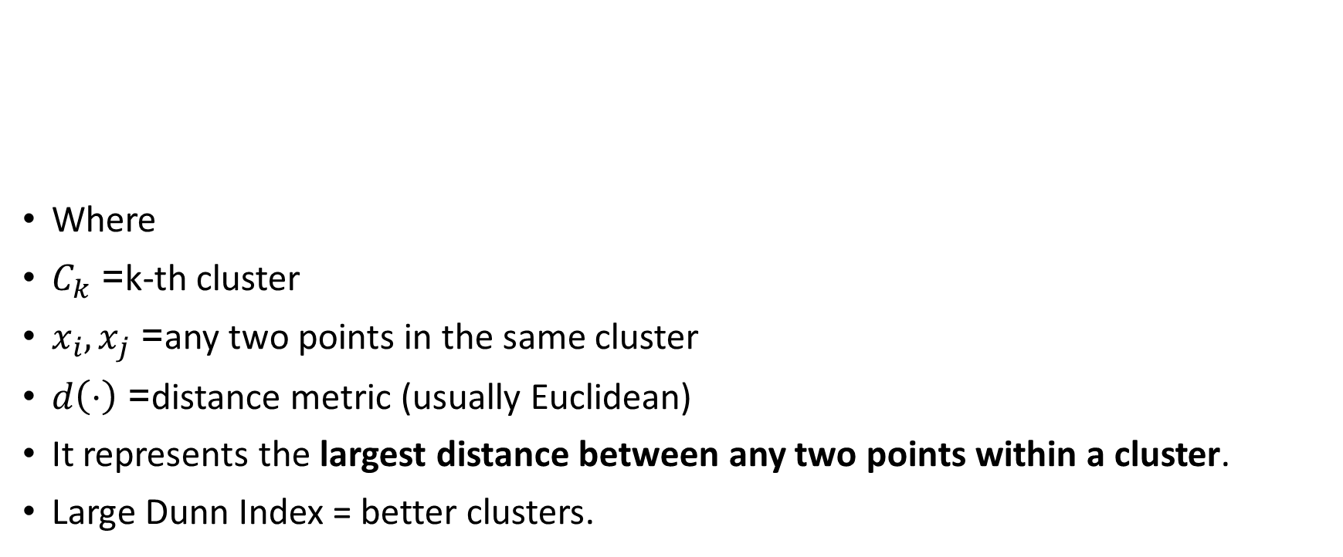
4. Dunn Index
Where
$C_{k}$= k-th cluster
$x_{i},x_{j}$= any two points in the same cluster
$d\left(⋅\right)$= distance metric (usually Euclidean)
It represents the largest distance between any two points within a cluster.
Large Dunn Index = better clusters.

Slide 29


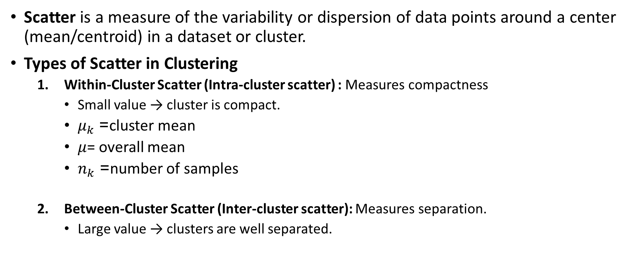
5. Scatter
Scatter is a measure of the variability or dispersion of data points around a center (mean/centroid) in a dataset or cluster.
Types of Scatter in Clustering
Within-Cluster Scatter (Intra-cluster scatter) : Measures compactness
Small value → cluster is compact.
$μ_{k}$= cluster mean
$μ$= overall mean
$n_{k}$= number of samples
Between-Cluster Scatter (Inter-cluster scatter): Measures separation.
Large value → clusters are well separated.

Slide 30
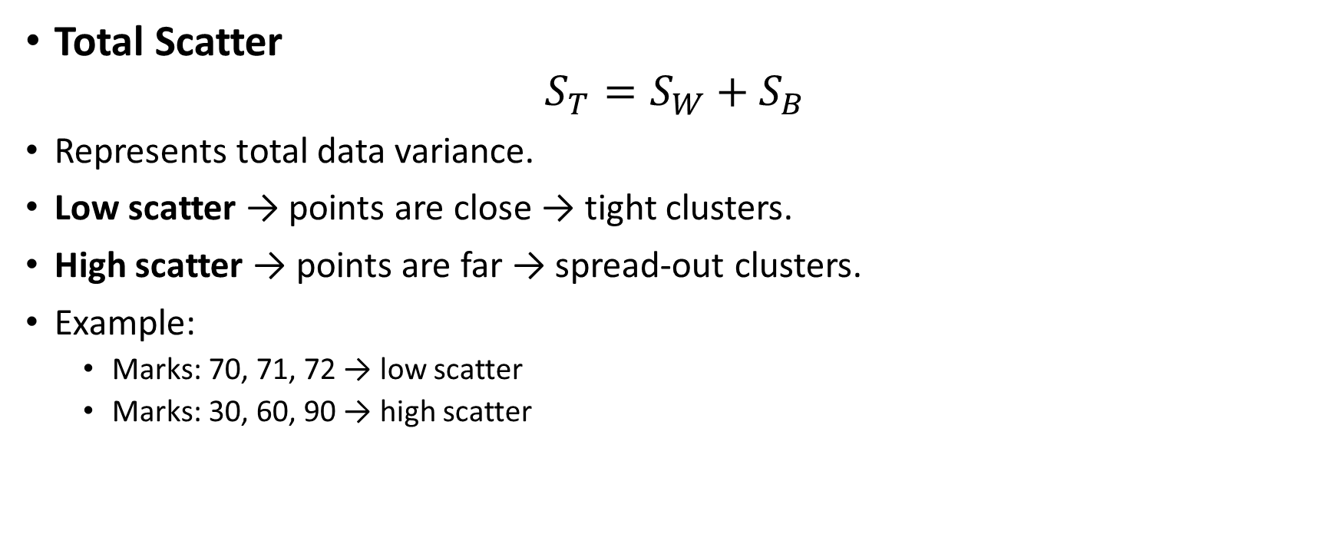
5. Scatter
Total Scatter
$$S_{T}=S_{W}+S_{B}$$
Represents total data variance.
Low scatter → points are close → tight clusters.
High scatter → points are far → spread-out clusters.
Example:
Marks: 70, 71, 72 → low scatter
Marks: 30, 60, 90 → high scatter

Slide 31
Clustering
Clustering is the task of identifying similar instances and assigning them to clusters, or groups of similar instances.
Two different kinds of clusters
Some algorithms look for instances centered around a particular point, called a centroid.
Others look for continuous regions of densely packed instances: these clusters can take on any shape.
Some algorithms are hierarchical, looking for clusters of clusters.

Slide 32
Application of Clustering
Clustering is used in a wide variety of applications, including these:
For customer segmentation
You can cluster your customers based on their purchases and their activity on your website.
This is useful to understand who your customers are and what they need, so you can adapt your products and marketing campaigns to each segment.
For example, customer segmentation can be useful in recommender systems to suggest content that other users in the same cluster enjoyed.
For data analysis
When you analyze a new dataset, it can be helpful to run a clustering algorithm, and then analyze each cluster separately.

Slide 33
Clustering
As a dimensionality reduction technique
Once a dataset has been clustered, it is usually possible to measure each instance’s affinity with each cluster (affinity is any measure of how well an instance fits into a cluster).
Each instance’s feature vector x can then be replaced with the vector of its cluster affinities.
If there are k clusters, then this vector is k-dimensional. This vector is typically much lower-dimensional than the original feature vector, but it can preserve enough information for further processing.
For anomaly detection (also called outlier detection)
Any instance that has a low affinity to all the clusters is likely to be an anomaly.
For example, if you have clustered the users of your website based on their behavior, you can detect users with unusual behavior, such as an unusual number of requests per second. Anomaly detection is particularly useful in detecting defects in manufacturing, or for fraud detection.

Slide 34
Clustering
For semi-supervised learning
If you only have a few labels, you could perform clustering and propagate the labels to all the instances in the same cluster. This technique can greatly increase the number of labels available for a subsequent supervised learning algorithm, and thus improve its performance.
For search engines
Some search engines let you search for images that are similar to a reference image. To build such a system, you would first apply a clustering algorithm to all the images in your database; similar images would end up in the same cluster.
Then when a user provides a reference image, all you need to do is use the trained clustering model to find this image’s cluster, and you can then simply return all the images from this cluster.
To segment an image
By clustering pixels according to their color, then replacing each pixel’s color with the mean color of its cluster, it is possible to considerably reduce the number of different colors in the image. Image segmentation is used in many object detection and tracking systems, as it makes it easier to detect the contour of each object.

Slide 35
K-Means Clustering
K-Means Clustering groups similar data points into clusters without needing labeled data. It is used to uncover hidden patterns when the goal is to organize data based on similarity.
Helps identify natural groupings in unlabeled datasets
Works by grouping points based on distance to cluster centers
Commonly used in customer segmentation, image compression, and pattern discovery
Useful when you need structure from raw, unorganized data
The vast majority of the instances were clearly assigned to the appropriate cluster, but a few instances were probably mislabeled (especially near the boundary between the top-left cluster and the central cluster).
Indeed, the K-Means algorithm does not behave very well when the blobs have very different diameters because all it cares about when assigning an instance to a cluster is the distance to the centroid.

Slide 36
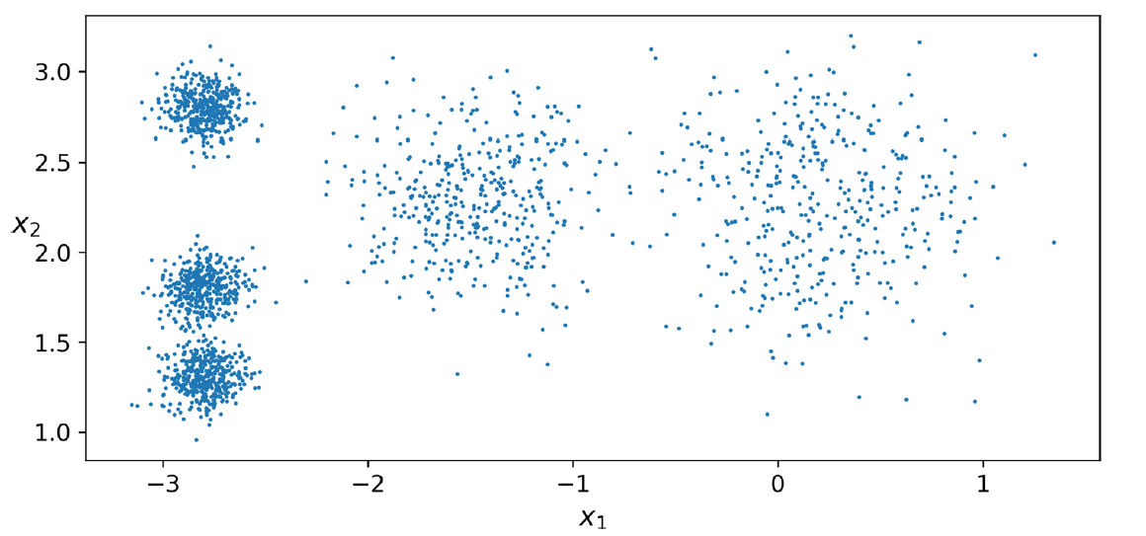
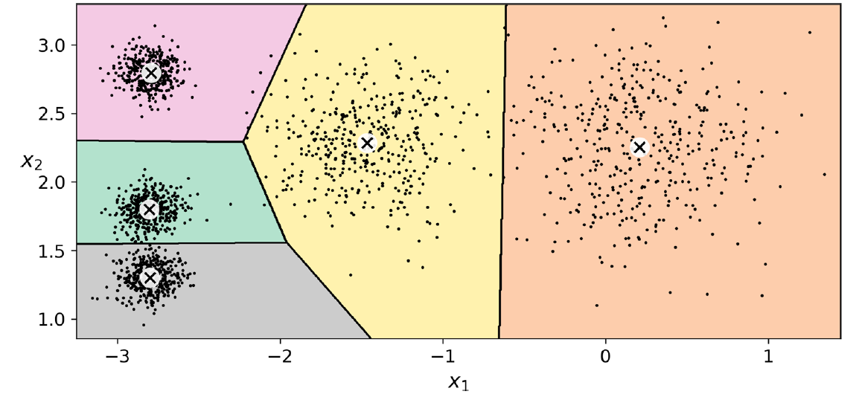
K-Means Clustering

Slide 37
K-means clustering
Instead of assigning each instance to a single cluster, which is called hard clustering, it can be useful to give each instance a score per cluster, which is called soft clustering.
The score can be the distance between the instance and the centroid; conversely, it can be a similarity score (or affinity), such as the Gaussian Radial Basis Function.
The computational complexity of the algorithm is generally linear with regard to the number of instances m, the number of clusters k, and the number of dimensions n. However, this is only true when the data has a clustering structure. If it does not, then in the worstcase scenario the complexity can increase exponentially with the number of instances. In practice, this rarely happens, and K-Means is generally one of the fastest clustering algorithms.

Slide 39
Steps in K-means clustering algorithm
Choose Number of Clusters (K)
Select the number of clusters K based on the problem requirement.
Methods like the Elbow Method can help in choosing optimal K.
Initializing Random Centroids
Randomly select K data points as the initial cluster centroids.
These centroids represent the center of each cluster.
Assign Data Points to Nearest Centroid
For each data point, compute the distance (usually Euclidean distance) from all centroids.
Assign each point to the cluster with the minimum distance.

Slide 40

Steps in K-means clustering algorithm
Update Centroids
Recalculate the centroid of each cluster by taking the mean of all points assigned to that cluster.
Check for Convergence
Compare old and new centroids.
If centroids do not change (or change is below a threshold), the algorithm stops.
Otherwise, repeat Steps 3 and 4.

Slide 41

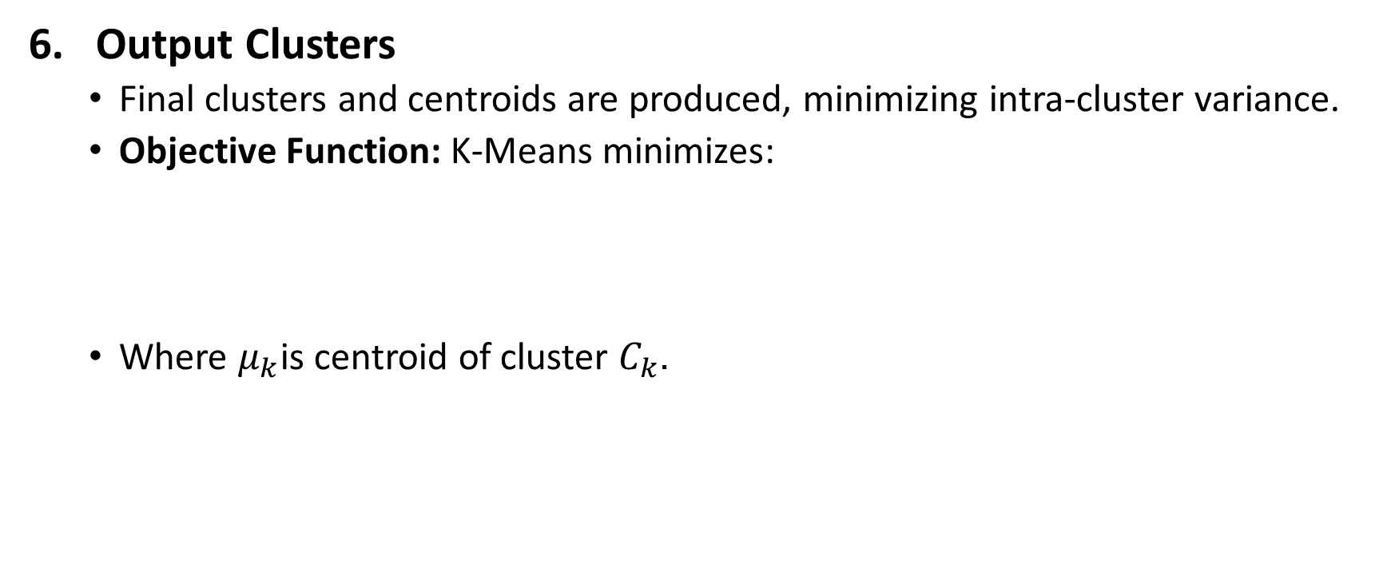
Steps in K-means clustering algorithm
Output Clusters
Final clusters and centroids are produced, minimizing intra-cluster variance.
Objective Function: K-Means minimizes:
Where $μ_{k}$is centroid of cluster $C_{k}$.

Slide 42
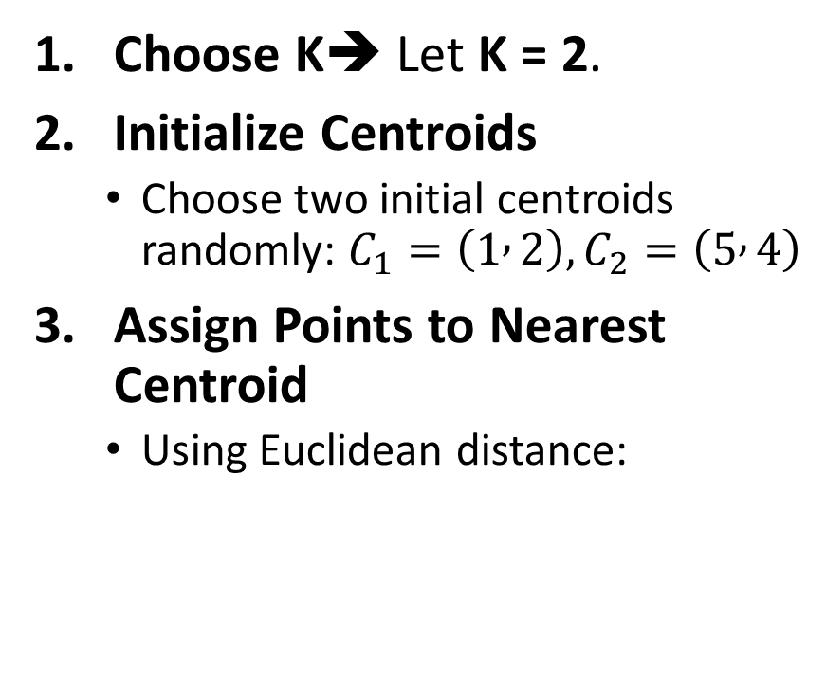
Simple Example of K-Means Clustering
Assume we have 6 data points representing students based on two features: Study Hours (X) and Marks (Y).
Choose K➔ Let K = 2.
Initialize Centroids
Choose two initial centroids randomly: $C_{1}=\left(1 , 2\right), C_{2}=\left(5 , 4\right)$
Assign Points to Nearest Centroid
Using Euclidean distance:
Student | X (Hours) | Y (Marks)
A | 1 | 2
B | 2 | 1
C | 4 | 5
D | 5 | 4
E | 6 | 5
F | 7 | 6

Slide 43
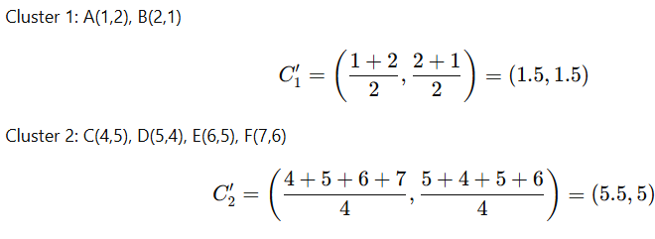


Simple Example of K-Means Clustering
Assign Points to Nearest Centroid
Using Euclidean distance:
Update Centroids
$$C_{1}=\left(1 , 2\right), C_{2}=\left(5 , 4\right)$$
Point | Dist to C₁ | Dist to C₂ | Cluster
A(1,2) | 0 | 4.47 | C₁
B(2,1) | 1.41 | 4.24 | C₁
C(4,5) | 4.24 | 1.41 | C₂
D(5,4) | 4.47 | 0 | C₂
E(6,5) | 5.66 | 1.41 | C₂
F(7,6) | 7.21 | 2.83 | C₂
Cluster 1 → A, B, Cluster 2 → C, D, E, F

Slide 44
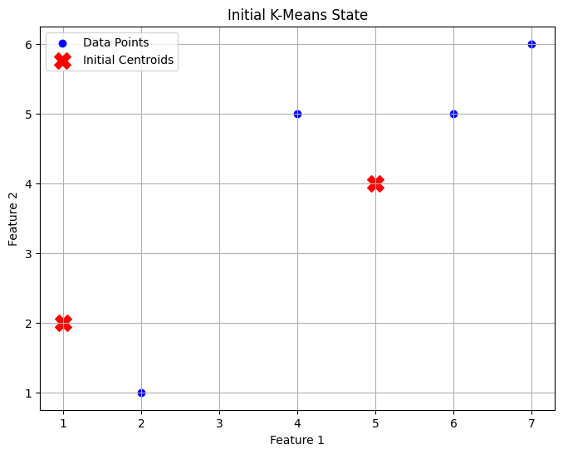
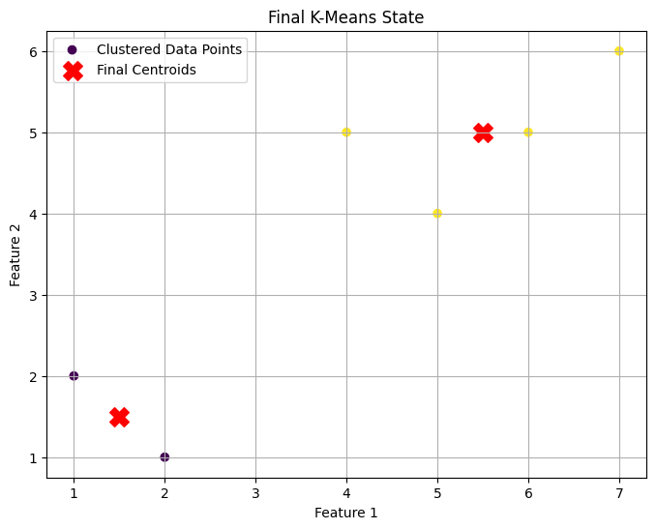
Simple Example of K-Means Clustering

Slide 45
Simple Example of K-Means Clustering
Repeat Step 3, 4
Assign Points to Nearest Centroid
Using Euclidean distance:
Update Centroids
$$C_{1}=\left(1.5 , 1.5\right), C_{2}=\left(5.5 , 5\right)$$
Point | d to C₁ | d to C₂ | Assigned Cluster
A | 0.71 | 5.41 | C₁
B | 0.71 | 5.32 | C₁
C | 4.30 | 1.50 | C₂
D | 4.30 | 1.12 | C₂
E | 5.70 | 0.50 | C₂
F | 7.11 | 1.80 | C₂
Cluster 1 → A, B, Cluster 2 → C, D, E, F

Slide 46
Limitations of k means clustering
K-means clustering needs the number of clusters to be specified.
K-means has problems when clusters are of differing sized, densities, and nonglobular shapes.
Presence of outlier can skew the results.

Slide 47
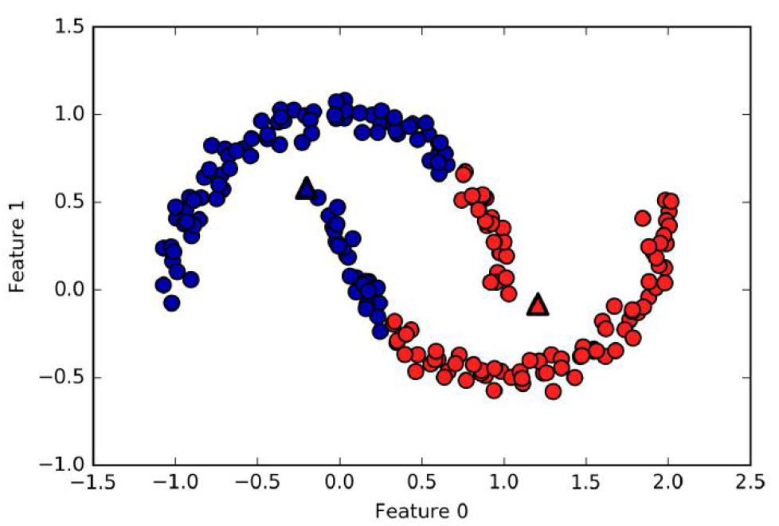
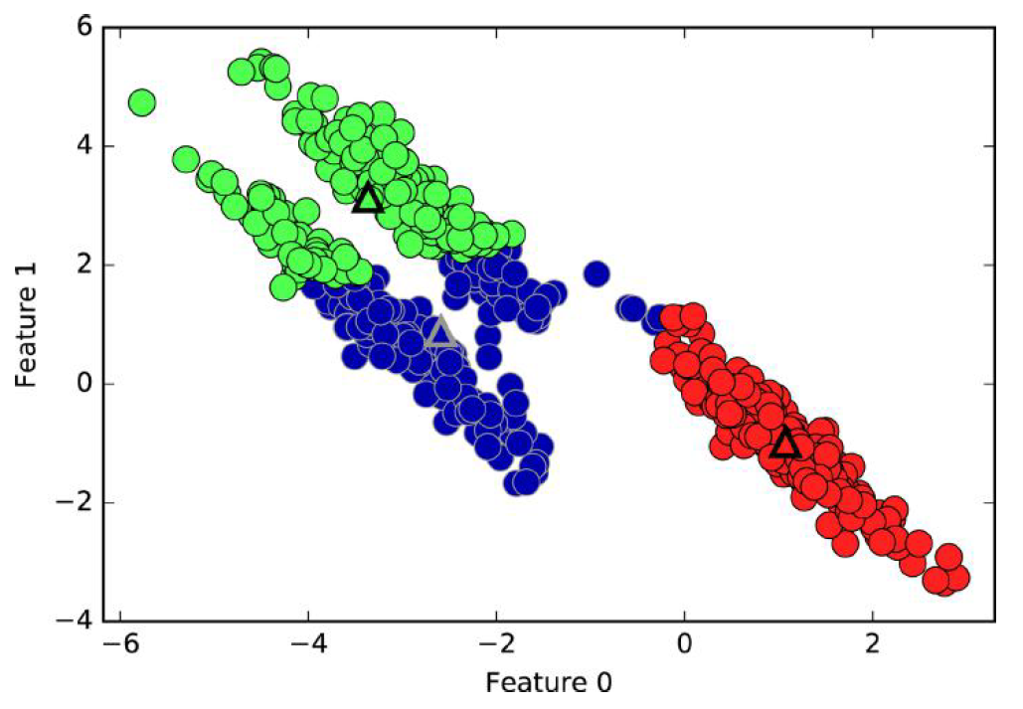
Failure cases of k-means
k-means fails to identify nonspherical clusters
k-means fails to identify clusters with complex shapes

Slide 48
Use cases
K-Means is widely used for many applications.
Image Segmentation
Clustering Gene Segmentation Data
News Article Clustering
Clustering Languages
Species Clustering
Anomaly Detection

Slide 49
K-Means++ Clustering
An important improvement to the K-Means algorithm, K-Means++, was proposed in a 2006 paper by David Arthur and Sergei Vassilvitskii.
They introduced a smarter initialization step that tends to select centroids that are distant from one another, and this improvement makes the K-Means algorithm much less likely to converge to a suboptimal solution.
They showed that the additional computation required for the smarter initialization step is well worth it because it makes it possible to drastically reduce the number of times the algorithm needs to be run to find the optimal solution.

Slide 50
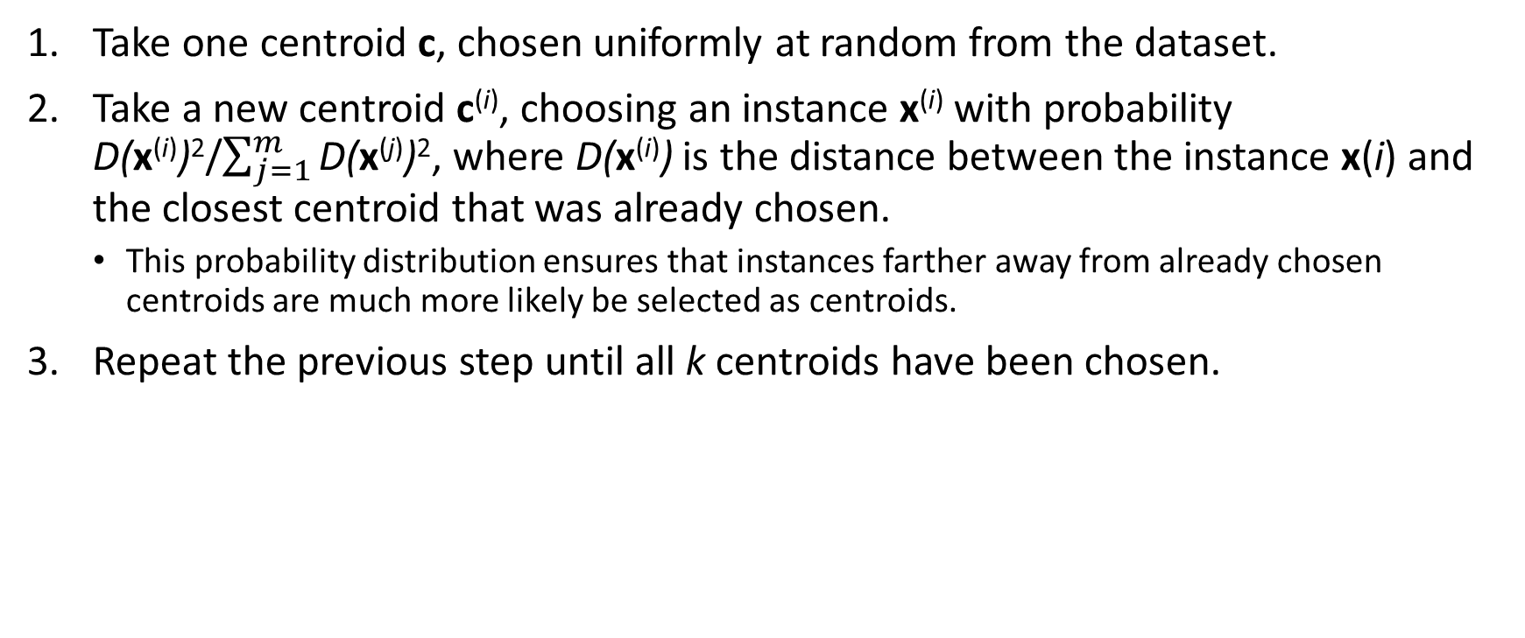
K-Means++ initialization algorithm:
Take one centroid c, chosen uniformly at random from the dataset.
Take a new centroid c^{(i)}, choosing an instance x^{(i)} with probability D(x^{(i)})²/$\sum_{j=1}^{m}{\text{D}\text{(}\text{x}\text{(}\text{j}\text{)}\text{)}\text{2}}$, where D(x^{(i)}) is the distance between the instance x(i) and the closest centroid that was already chosen.
This probability distribution ensures that instances farther away from already chosen centroids are much more likely be selected as centroids.
Repeat the previous step until all k centroids have been chosen.

Slide 51

Simple Example of K-Means++ Clustering
Assume we have 6 data points representing students based on two features: Study Hours (X) and Marks (Y).
Choose K➔ Let K = 2.
Choose First Centroid Randomly: $C_{1}=\left(1 , 2\right)$
Compute Distance² from $C_{1}$
Point | Distance from (1,2) | Distance²
A(1,2) | 0 | 0
B(2,1) | √2 ≈ 1.41 | 2
C(4,5) | √18 ≈ 4.24 | 18
D(5,4) | √20 ≈ 4.47 | 20
E(6,5) | √34 ≈ 5.83 | 34
F(7,6) | √52 ≈ 7.21 | 52
Student | X (Hours) | Y (Marks)
A | 1 | 2
B | 2 | 1
C | 4 | 5
D | 5 | 4
E | 6 | 5
F | 7 | 6
The largest value is for F(7,6). So choose: $C_{2}=\left(7 , 6\right)$

Slide 52
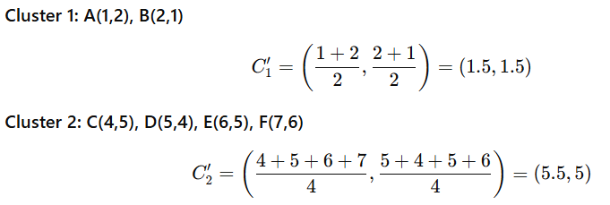

Simple Example of K-Means++ Clustering
Assign Points to Nearest Centroid
Compute distance to $C_{1}\left(1 , 2\right)$and $C_{2}\left(7 , 6\right)$
Update Centroids
Point | d to C₁ | d to C₂ | Cluster
A(1,2) | 0 | 7.21 | C₁
B(2,1) | 1.41 | 7.07 | C₁
C(4,5) | 4.24 | 3.61 | C₂
D(5,4) | 4.47 | 2.83 | C₂
E(6,5) | 5.83 | 1.41 | C₂
F(7,6) | 7.21 | 0 | C₂
So:
Cluster 1: A, B
Cluster 2: C, D, E, F

Slide 53
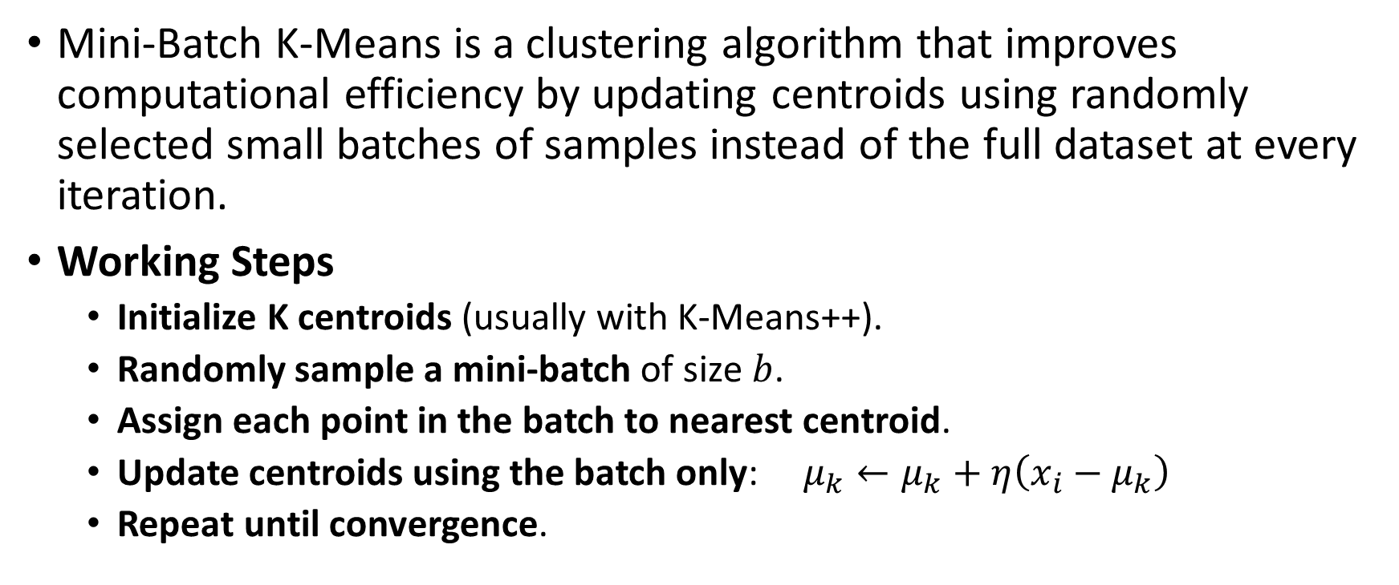
Mini-Batch K-Means
Mini-Batch K-Means is a clustering algorithm that improves computational efficiency by updating centroids using randomly selected small batches of samples instead of the full dataset at every iteration.
Working Steps
Initialize K centroids (usually with K-Means++).
Randomly sample a mini-batch of size $b$.
Assign each point in the batch to nearest centroid.
Update centroids using the batch only: $μ_{k}←μ_{k}+η\left(x_{i}−μ_{k}\right)$
Repeat until convergence.

Slide 54
Feature | K-Means | K-Means++ | Mini-Batch K-Means
Initialization | Random centroids | Smart (distance-based) initialization | Uses K-Means++ usually
Dataset size | Small–medium | Medium–large | Very large datasets
Speed | Moderate | Faster than K-Means | Very fast
Memory use | Higher | Same as K-Means | Low
Convergence | Slower, unstable | Faster, stable | Fast, approximate
Cluster quality | Can be poor due to random start | Better, more consistent | Slightly less accurate
Iterations | More | Fewer | Very few
Sensitivity | Sensitive to initialization | Less sensitive | Less sensitive
Scalability | Limited | Better | Highly scalable
Use case | Simple problems | Production clustering | Big data / streaming data

